Slide 1
Winter term 2024
By paige fields

Slide 2

Core productivity and time mangement
I have learned.
This Photo by Unknown author is licensed under CC BY-NC.

Slide 3

Intro 2d design
I have learned.

Slide 4

Design 4all
I have learned.

Slide 5
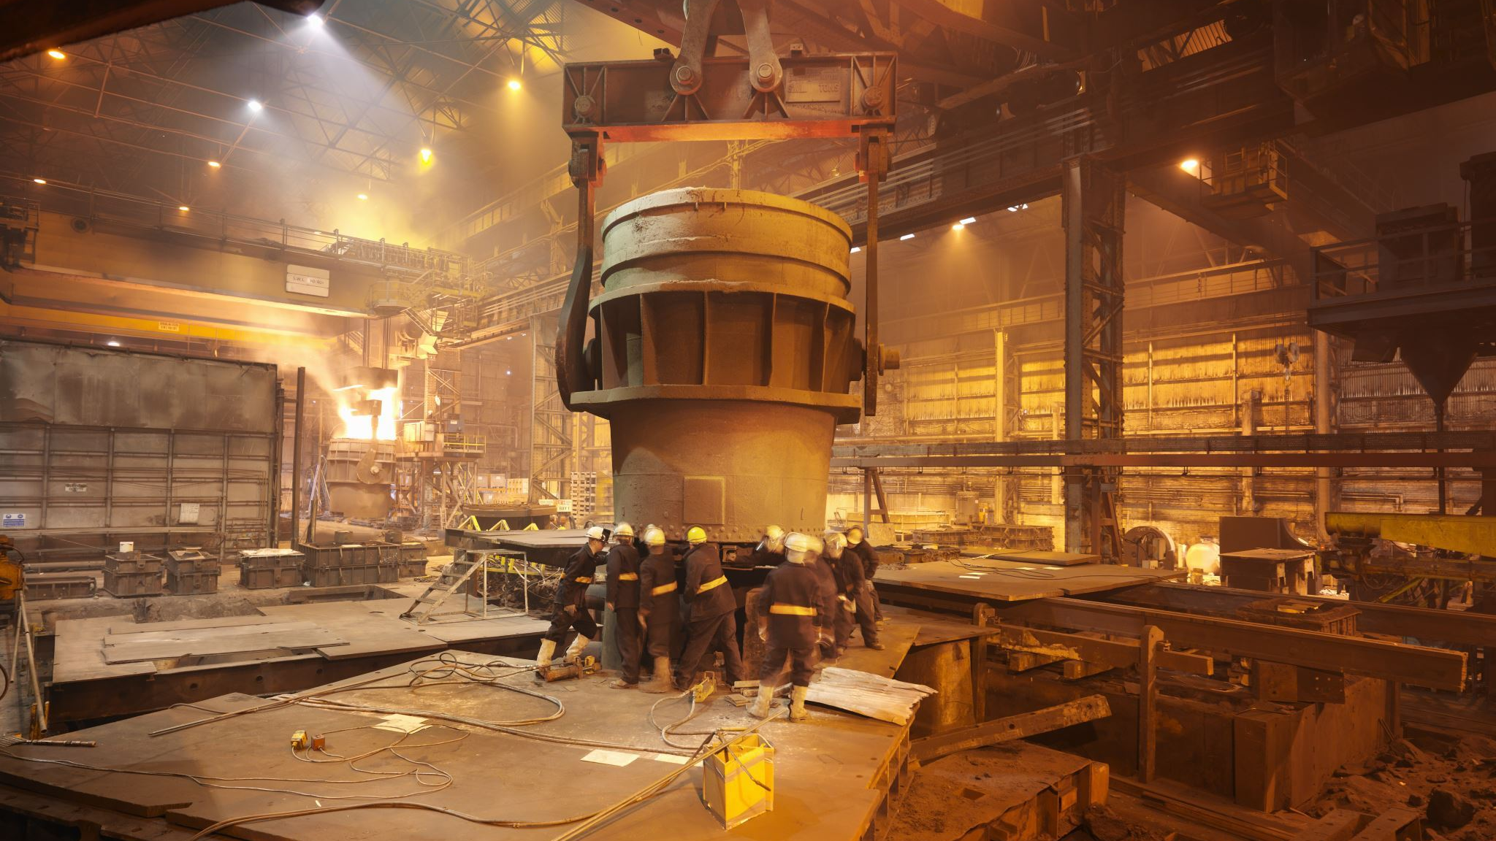
production
I have learned.

Slide 6

Favorite memory
My favorite memory is I am enjoying sam lunch on wednesday
So I can spend more time with people.

